Slide 1
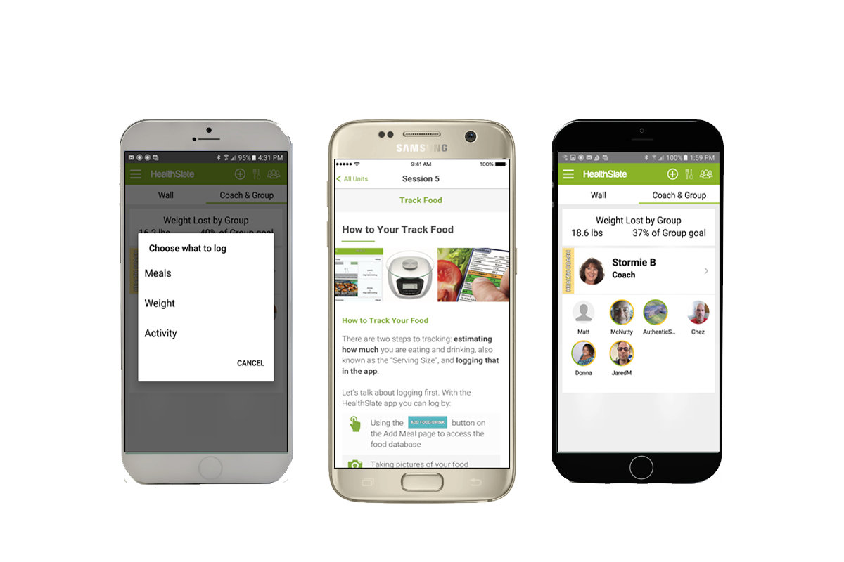
The HealthSlate Platform for In-Person DPPs

Slide 2
Agenda
Background and landscape
Delivering in-person DPP efficiently and effectively
Offering digital DPP as well
Reimbursement and fees
Question and answers

Slide 3
About HealthSlate
Background
5 years developing diabetes education and prevention tools
HealthSlate tablet, A to Z Health patient education videos
Used at > 1,000 accredited diabetes education programs
Our Telehealth DSME/T Program
Enables diabetes education programs to expand access
Delivers outcomes equal to in-person diabetes education

Slide 4
The Changing DPP Landscape
Medicare coverage begins January 1, 2018
Will include both in-person and digital delivery
Many commercial plans adding coverage before 2018
Important to pilot your program SOON
Other DPP providers entering market
Medicare rules require 6 months’ outcomes data

Slide 5
Challenges for Coaches and Coordinators
Copying and distributing participant handouts
Entering data needed for reporting
Scheduling and delivering make-up classes
Monitoring and improving program
Only half of participants reach 5% weight loss, so proposed Medicare reimbursement is challenging
Scaling and operating at break-even very challenging

Slide 6
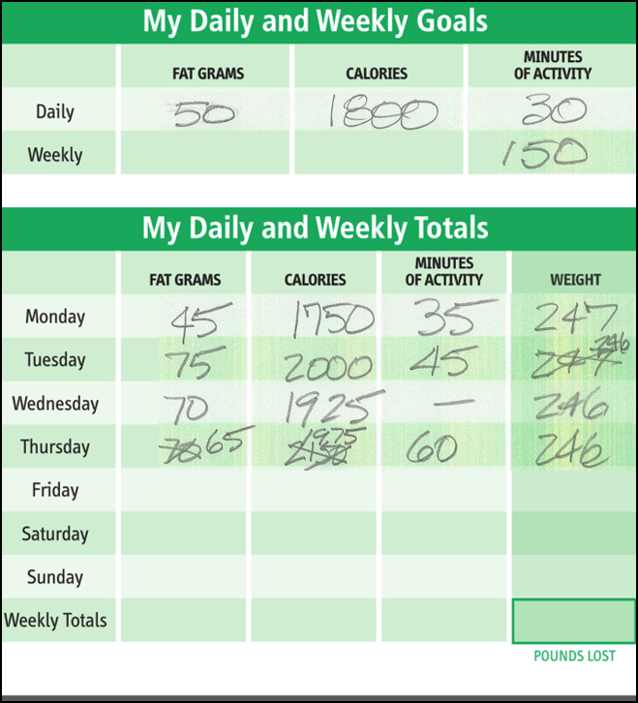

Challenges for Participants
Paper trackers are cumbersome
Staying on track long term requires ongoing support
Committing to all sessions in-person difficult for many people

Slide 7
We Address These Challenges
Tools to make in-person DPP more efficient, effective
100% Digital DPP for those who can’t attend in-person
This is about 50% of all participants
You retain control of patient relationship and brand

Slide 8
The HealthSlate Platform for In-Person DPPs
In-person DPPs use elements of digital DPP to
Recruit more participants
Increase number of groups each coach can support
Make DPP more effective long term for participants
Collect “clean” data for CDC reporting
Platform Components
Participant App
Logging via app instead of paper tracker
Digital version of Prevent T2 curriculum
App is optional; paper tracker still can be used
Web-based tools for Program Coordinators and Coaches

Slide 9


Slide 10


Slide 11



Slide 12
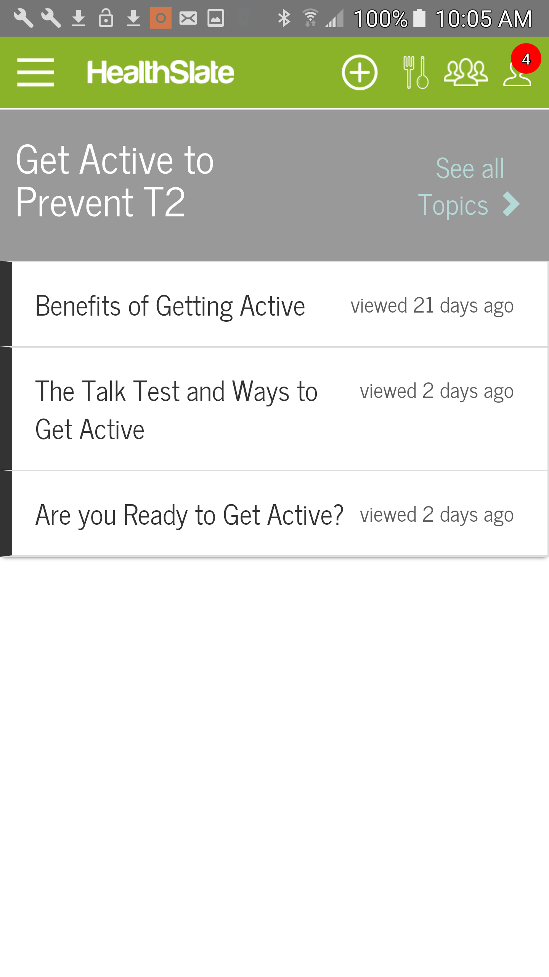
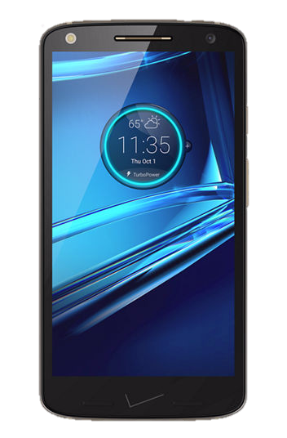
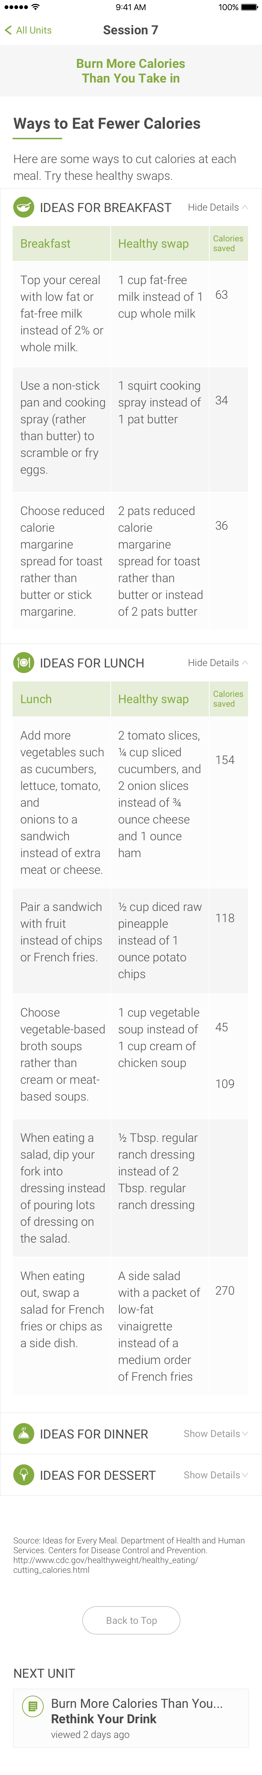


Interactive Prevent T2 Curriculum
No more paper based handouts
Animations are engaging and work for all literacy levels
Lifestyle Coach can play animations in class
Spanish version available in Q1 2017

Slide 13
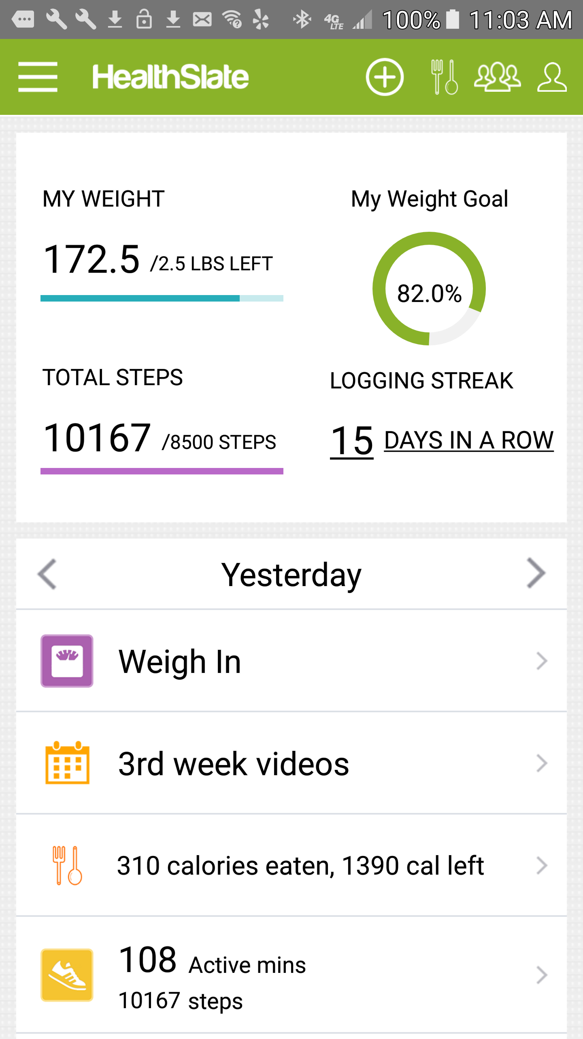
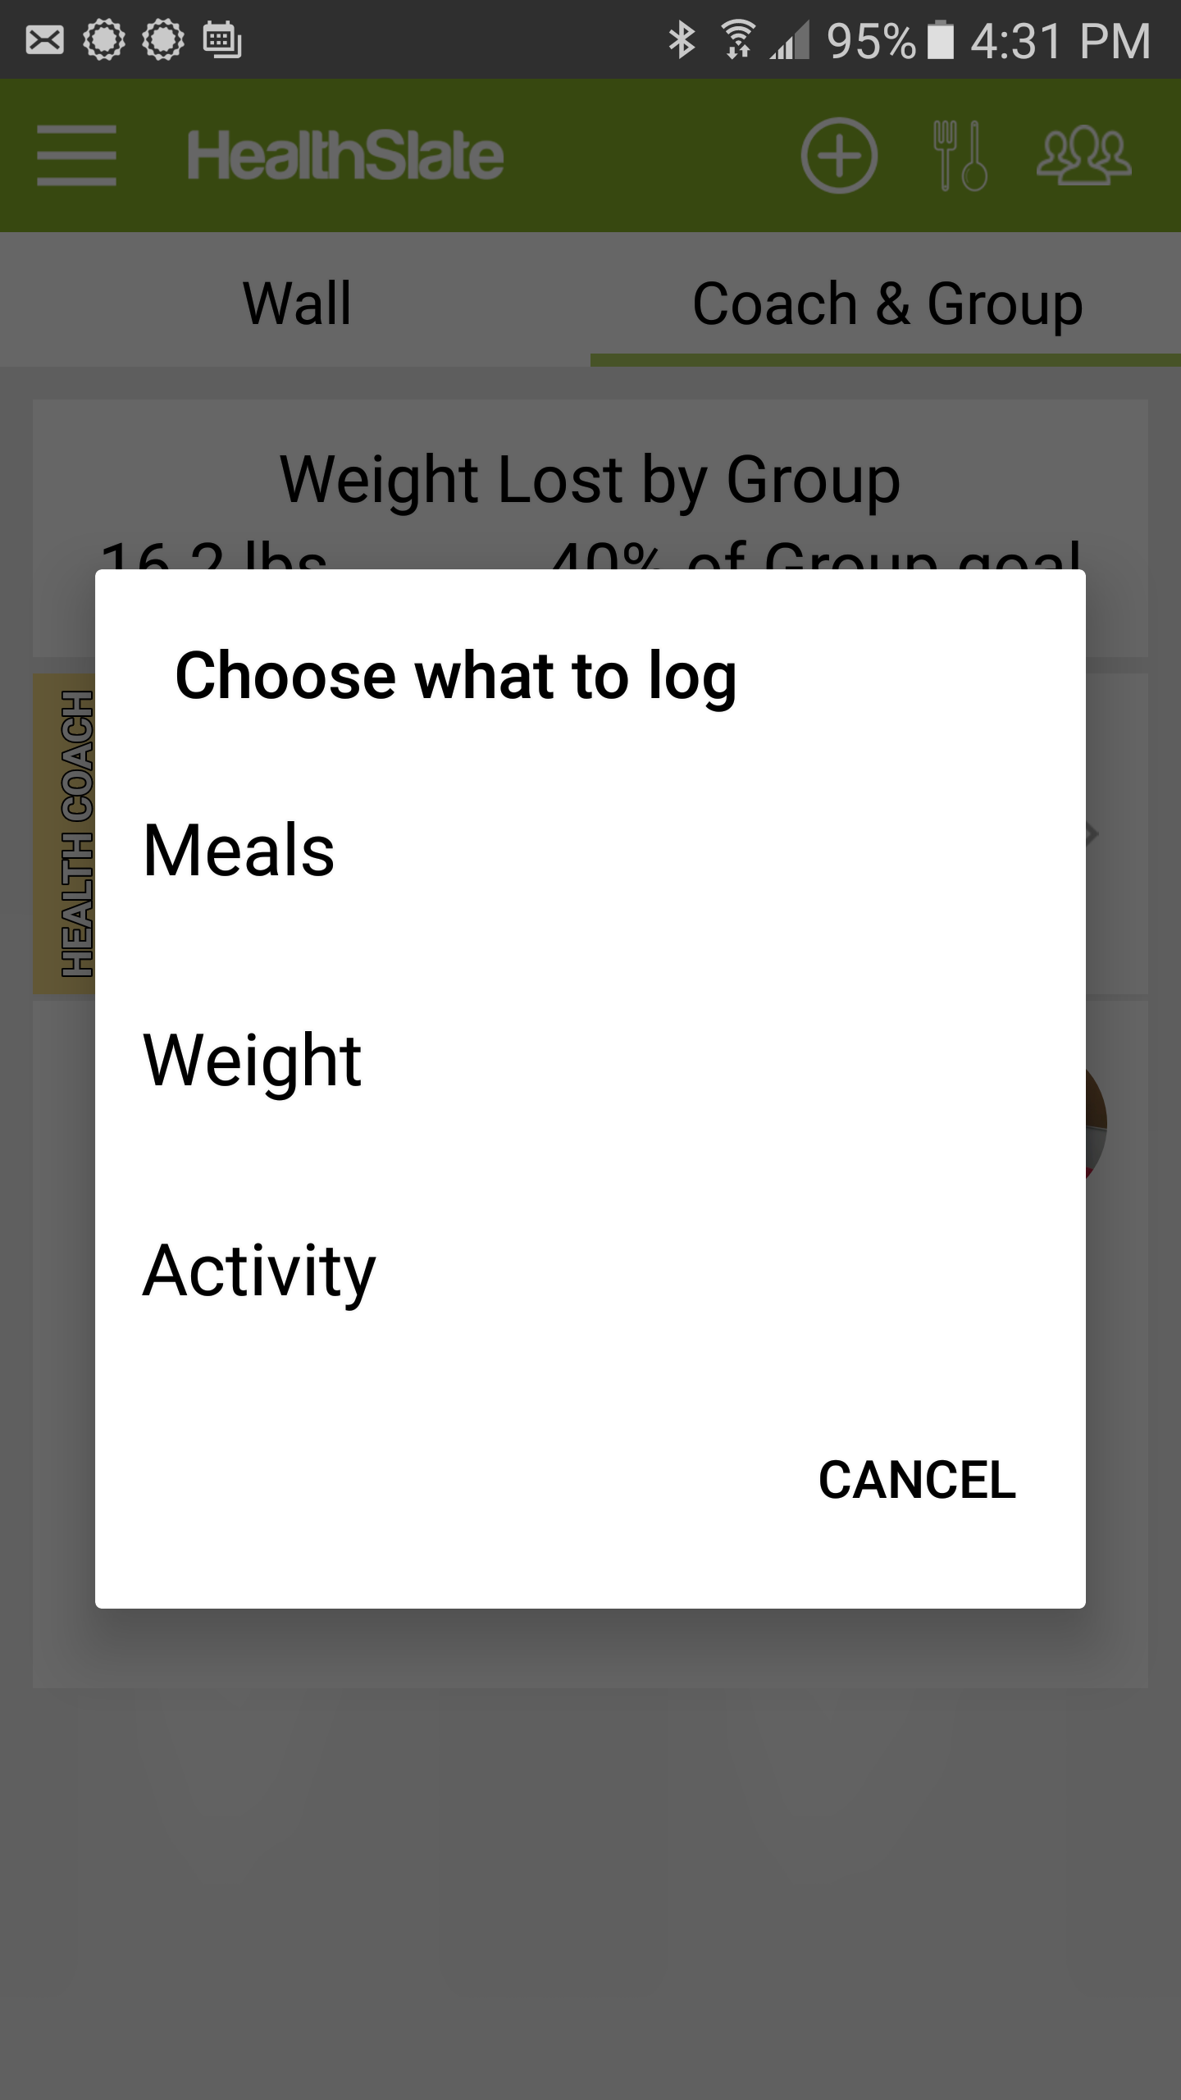
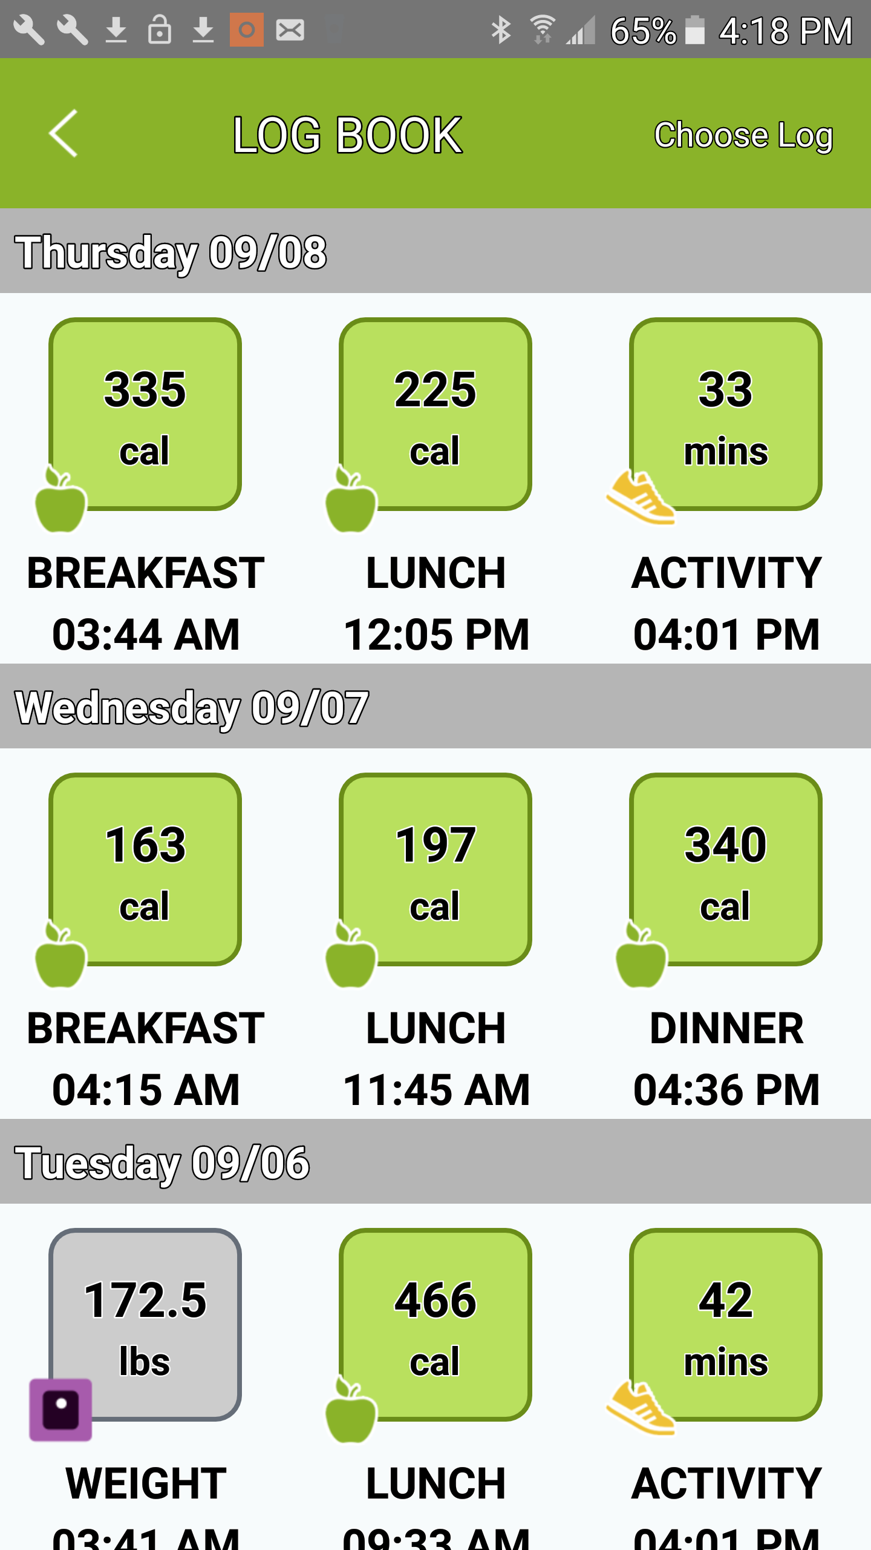
App-based logging
Simplifies logging and reporting for participant, coach and program coordinator

Slide 14
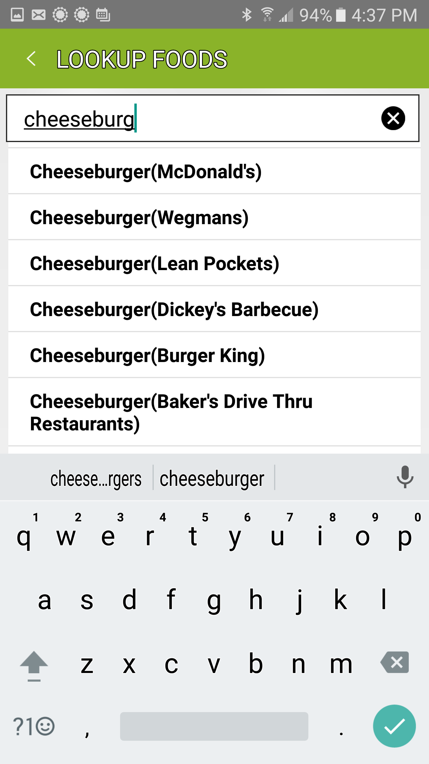
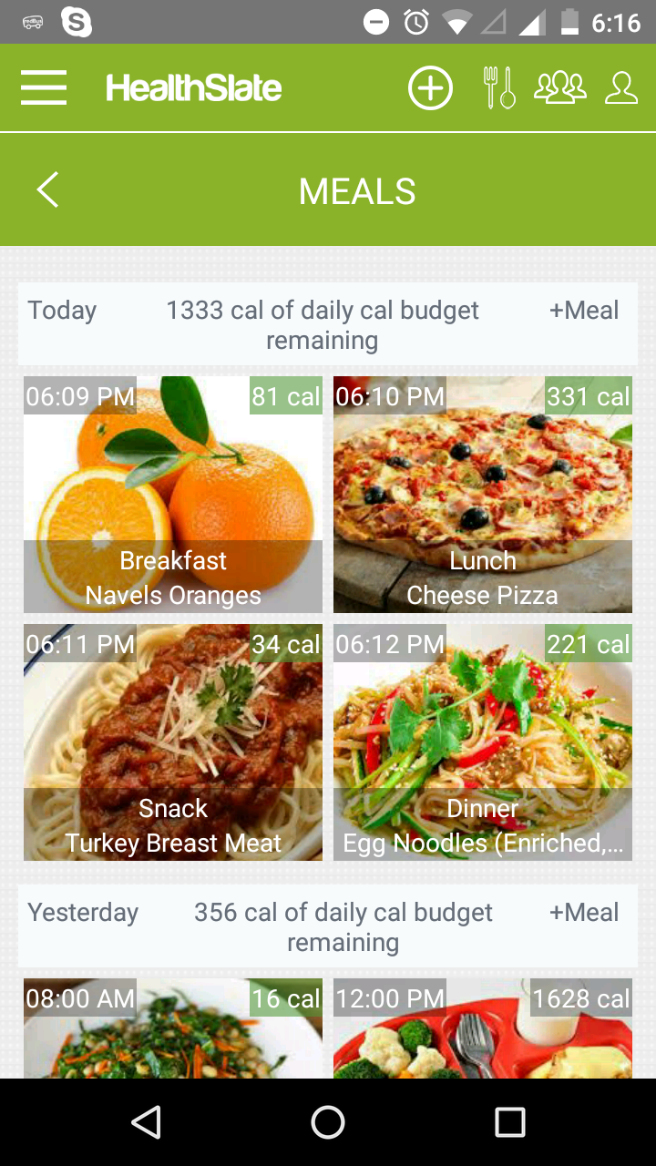
App-based Food logging
Prevent T2-compliant calorie budgets
Food database
Results tracked by coach

Slide 15
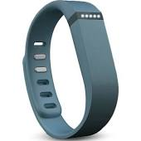
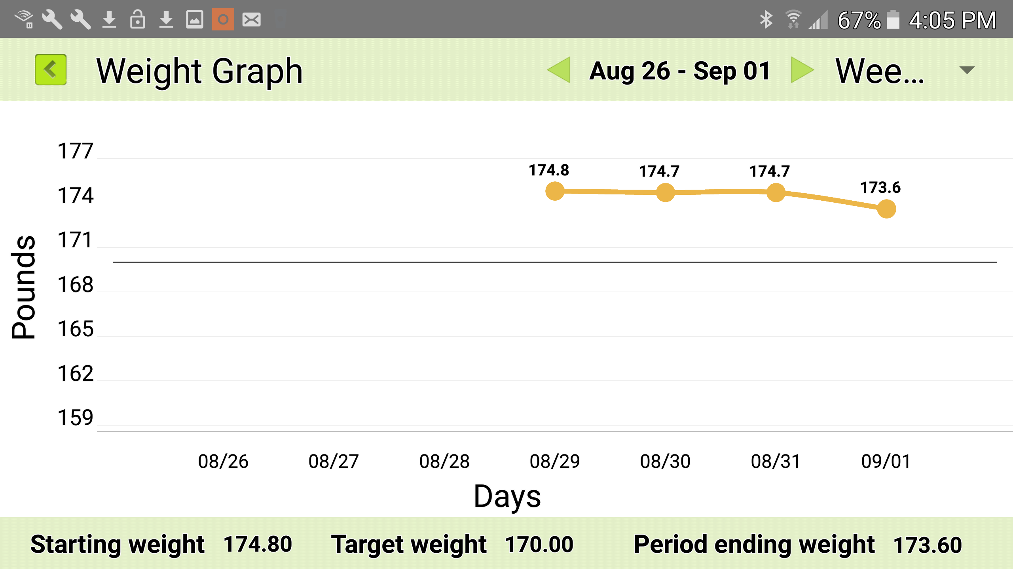
App-based Weight and Activity Logging
Weight logged manually or via wireless scale
Activity logged manually or via linked Fitbit

Slide 16
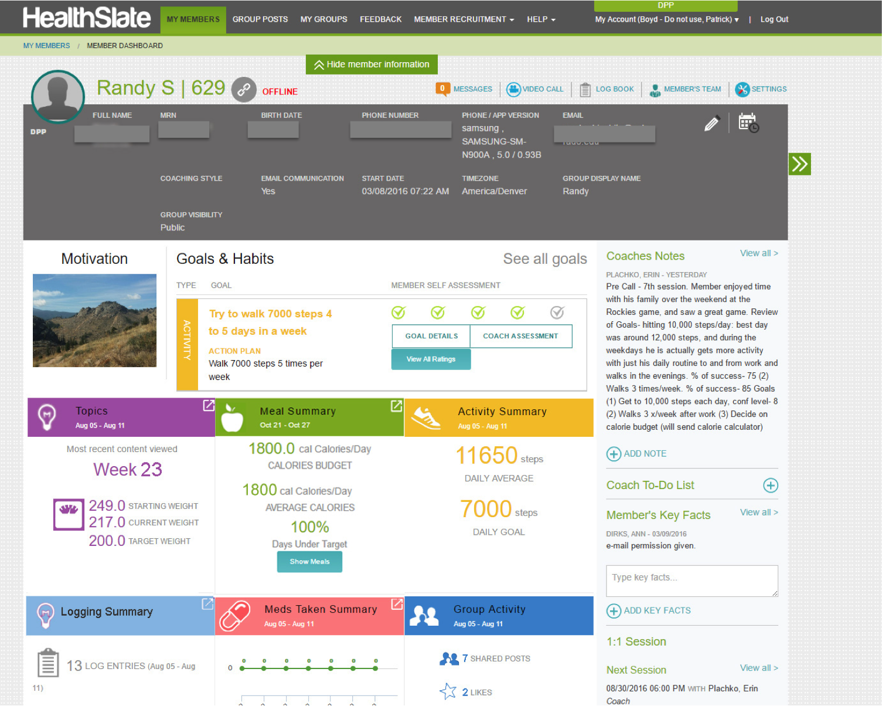

Slide 17
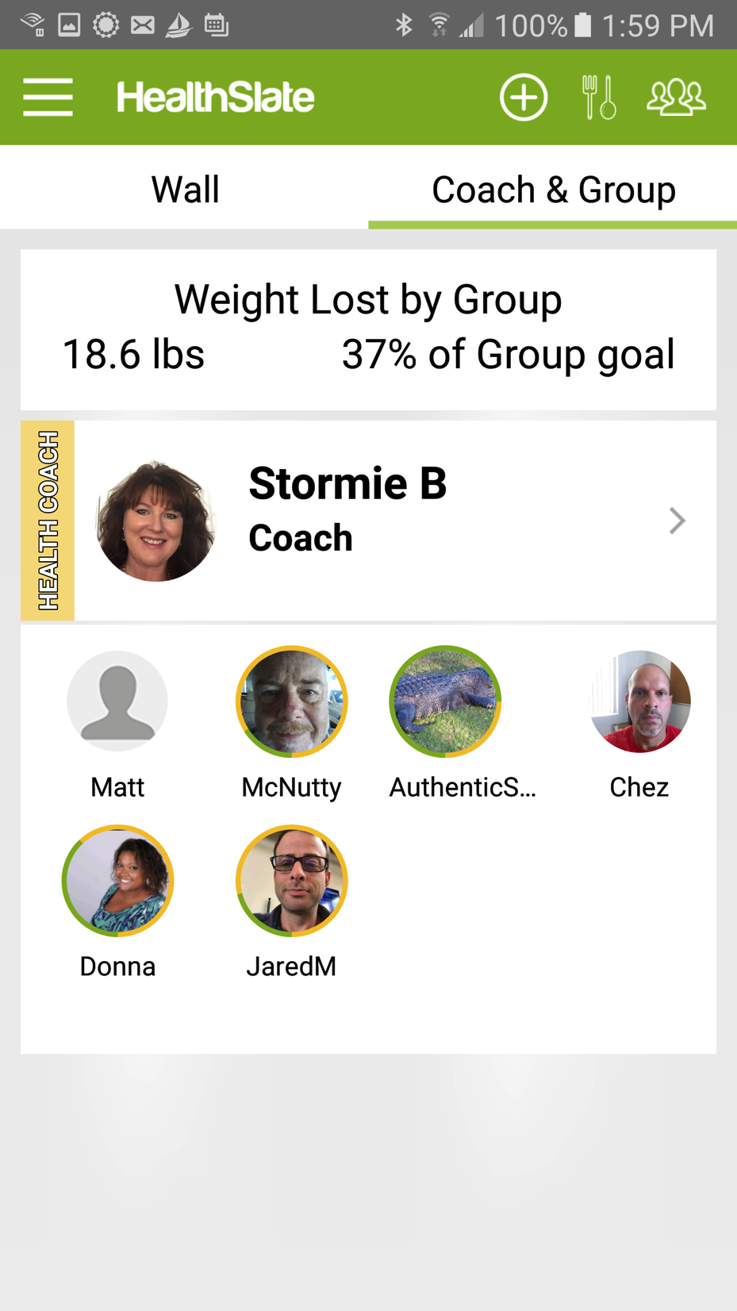
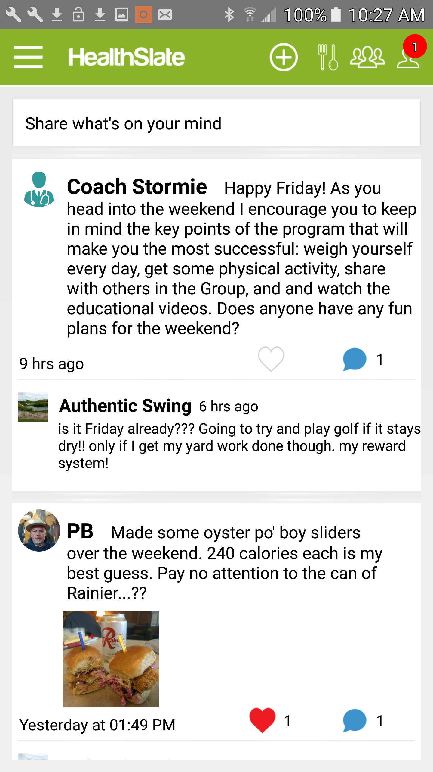
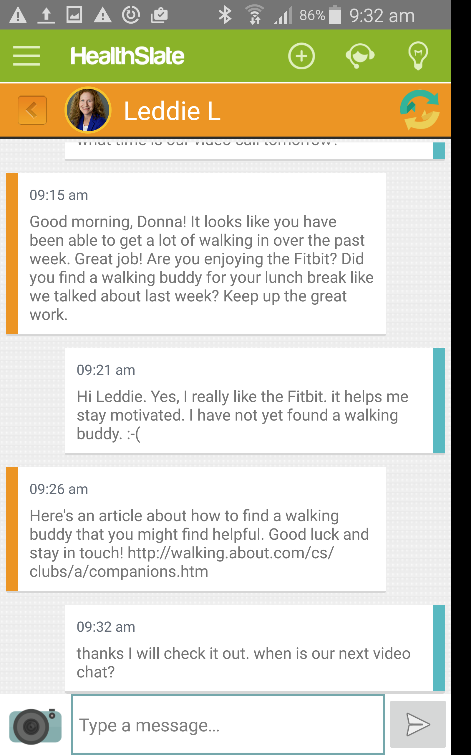
Support in App from Coach and Group
Can also be used to recruit and retain participants

Slide 18
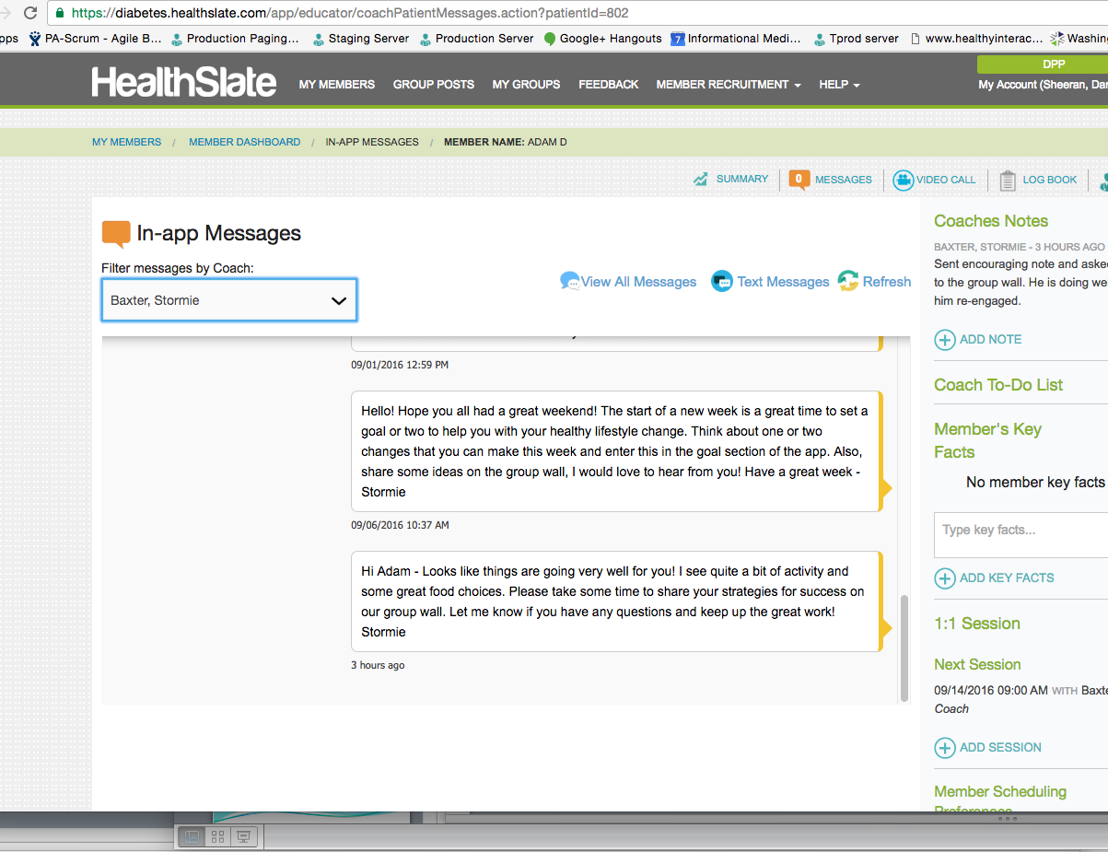
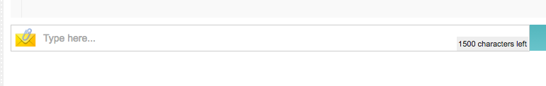
Coach Tools for Interacting with Participant & Group
1:1 and group messaging tool allows coaches to support members very efficiently

Slide 19
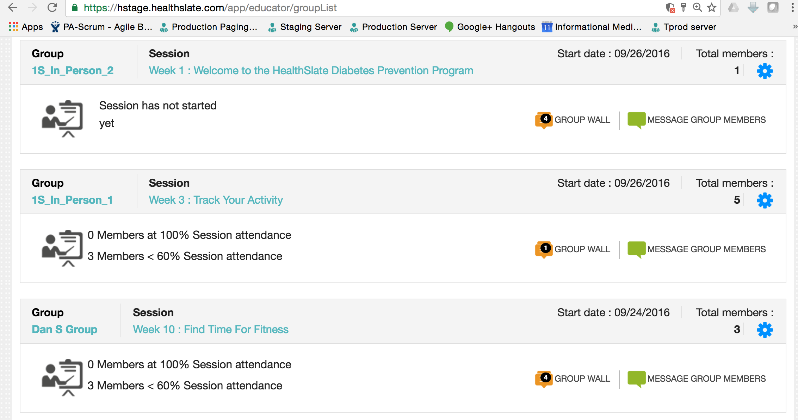
Quickly View and Manage All Cohorts

Slide 20
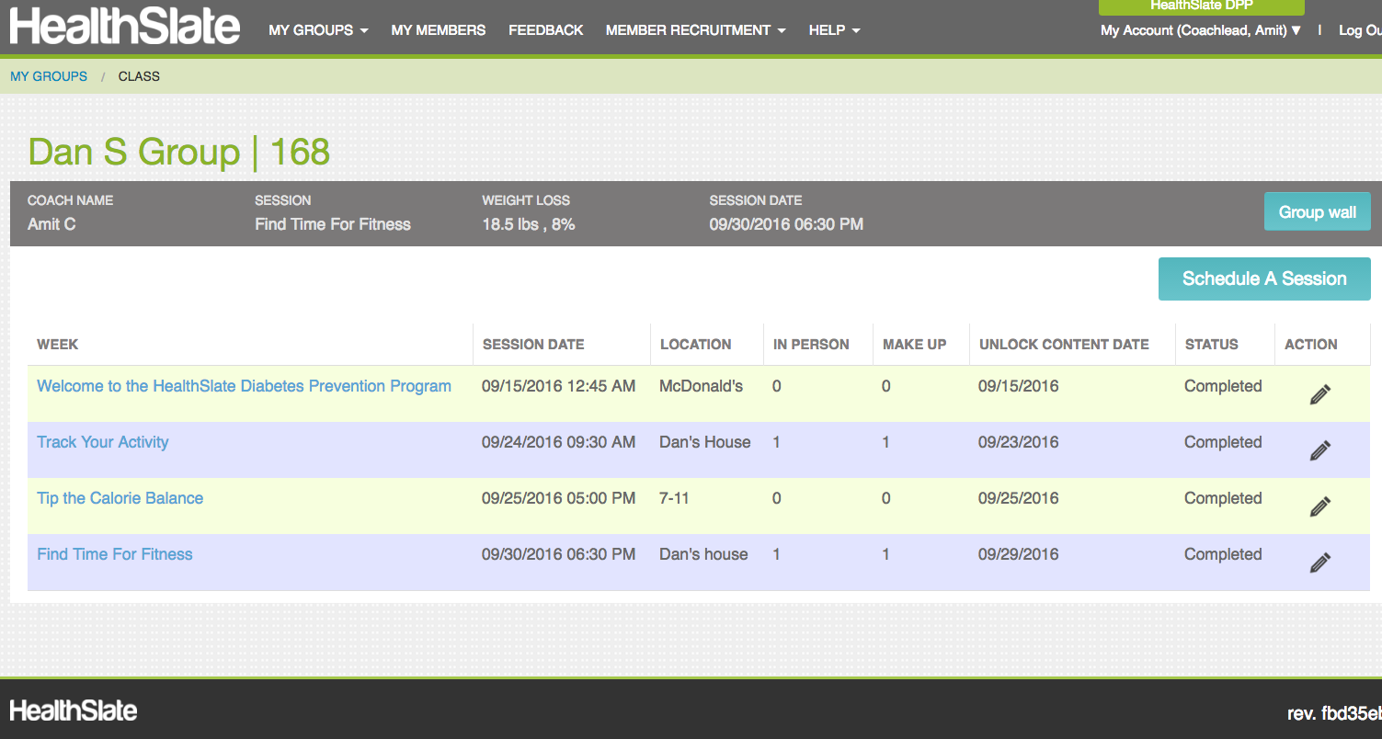
Web-Based Tools for Scheduling Sessions

Slide 21
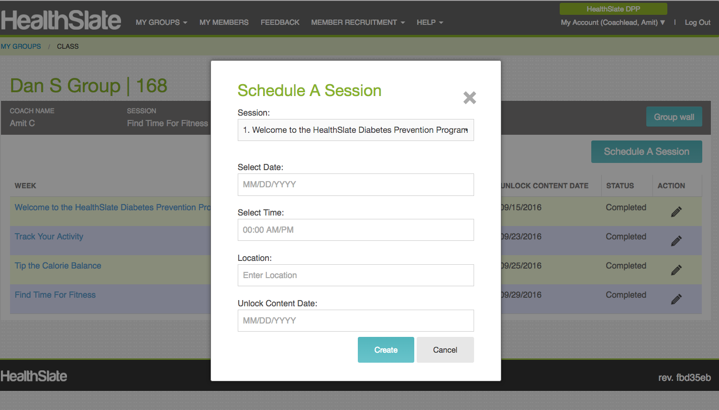
Web-Based Tools for Scheduling Sessions

Slide 22
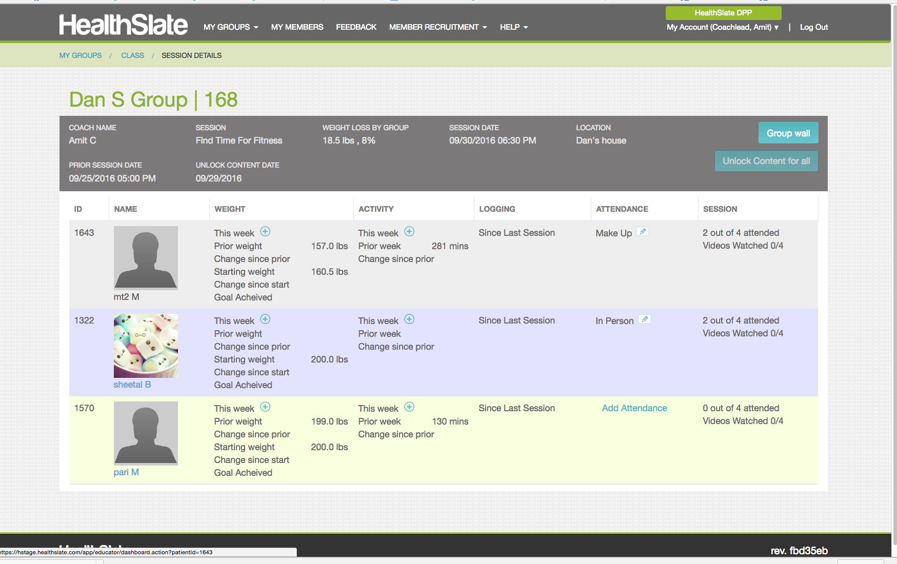
Web-Based Tools for Running Sessions

Slide 23
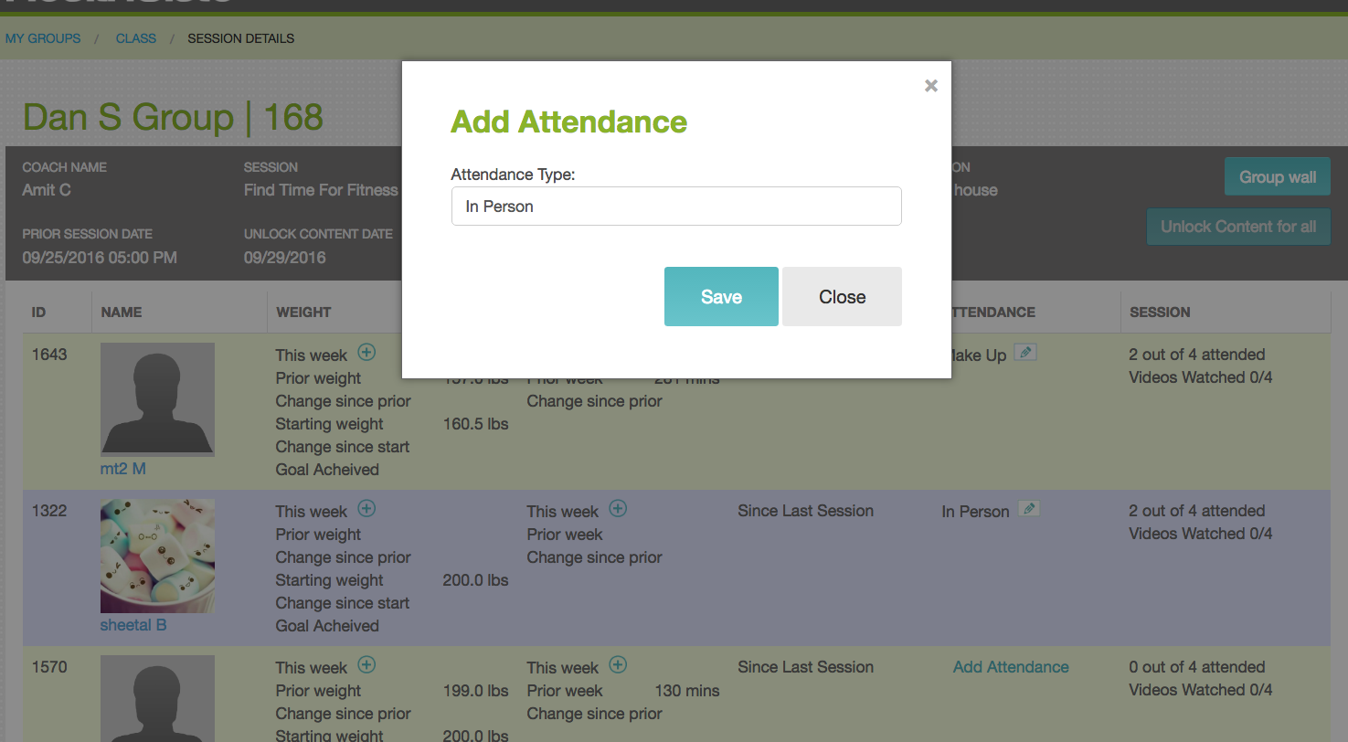
Web-Based Tools for Running Sessions

Slide 24
Participant Makes Up Missed Session On Own Time
Participant receives message in app asking her to complete missed session
She is automatically recorded as Attended after she completes session and logs weight
Participants attending in-person can also review curriculum via app

Slide 25
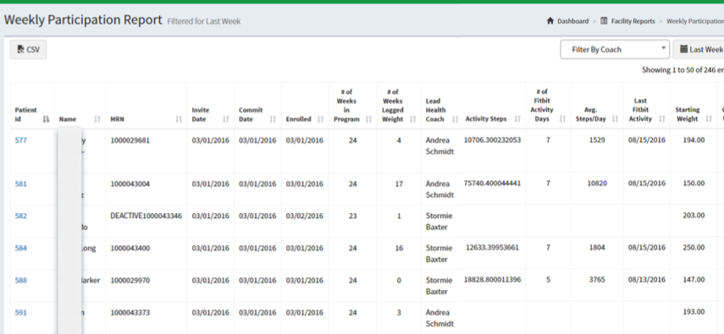
Program Coordinator Tools for Monitoring Outcomes
Data formats can be modified as needed for CDC and Payer Reporting

Slide 26

Options for Launching Your DPP
Launch and operate yourself
Identify DPP Program Coordinator
Recruit and train Lifestyle Coaches
Obtain insurance coverage
Partner with ABC Diabetes
Consulting services to help you get started
Turnkey operation under your brand

Slide 27
Reimbursement and Fees

Slide 28
Reimbursement: Grants and Public Employees
Grant-based deployments
Usually not outcomes-based
Typically around $429 - $500 per “enrolled” participant
Many states now cover DPP for public employees
Contact your state DPCP office to learn who is covered

Slide 29
Medicare Rules on DPP
Draft rules issued this summer; comment period now past
Final rules expected before year end
To start billing Medicare in January 2018, you must:
Have had CDC Pending Recognition for at least 1 year
Therefore, register for Pending Recognition by 12/1/16
You must launch first cohort within 6 months of receiving Pending Recognition (before July 1, 2017)

Slide 30
Medicare Rules on DPP
Issues to Track
Do coaches need to have an NPI?
Degree to which reimbursement is based on outcomes
We will offer webinar on final rules after CMS publishes
CDC resources
https://innovation.cms.gov/initiatives/medicare-diabetes-prevention-program/
https://innovation.cms.gov/Files/slides/mdpp-overview-slides.pdf

Slide 31
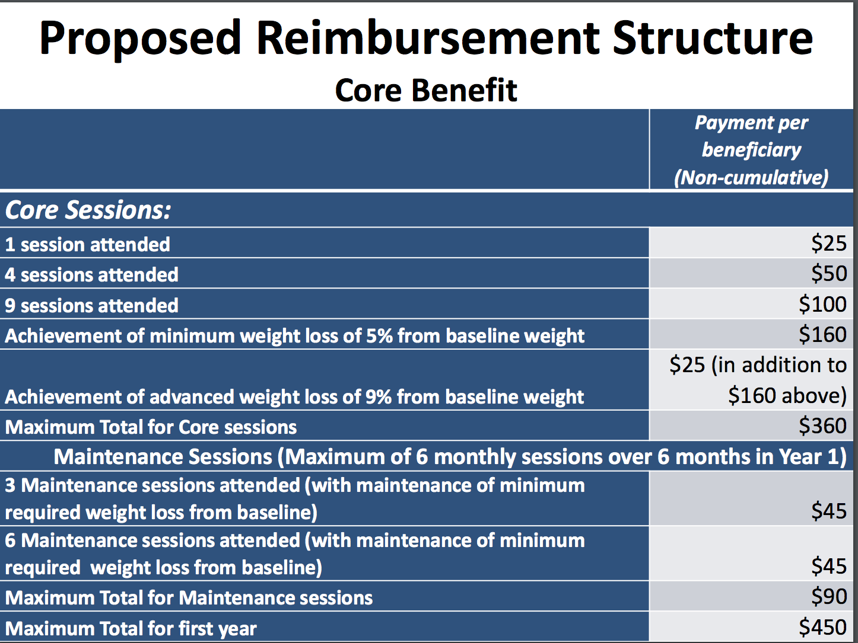

Slide 32
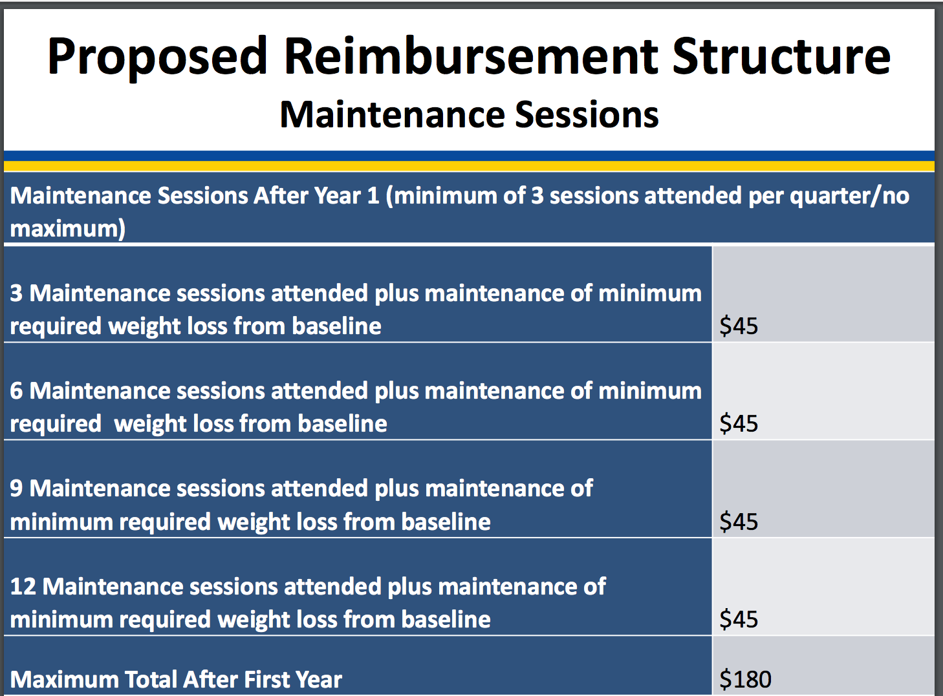
Communicating with participants via app will GREATLY increases maintenance attainment

Slide 33
Reimbursement: Commercial Insurers
All payers expected to cover DPP by end of 2018
We can help you obtain coverage with commercial plans
Have secured coverage with major payers in
California
Florida
Colorado
Expect to have coverage with at least 2 of the big 4 national carriers by mid-2017
Reimbursement based on attendance and outcomes

Slide 34
Tentative HealthSlate Fee Structure
In-Person DPP fees
Base fee of $30/participant for those who qualify as “Enrolled”
No charge for participants who do not make it to 4 sessions
Startup costs
$500 fee to train Program Coordinator and up to 3 Lifestyle Coaches on use of HealthSlate Platform, and
Prepay for first 15 participants @ $30/participant = $450 (the cohort you need to run to obtain MDPP Preliminary Recognition)
$950 total; likely available via grants
Digital DPP fees depend on insurer reimbursement rate

Slide 35
Q & A and Next Steps
To follow up with us on next steps and questions…
Register at www.healthslate.com/dpp
Or
Contact Us directly
HealthSlate contact:
Pat Boyd: patrickboyd@healthslate.com
ABC Diabetes contact:
Mike Freedman: mike@abcdiabetes.com

